Slide 1
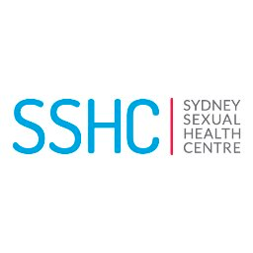
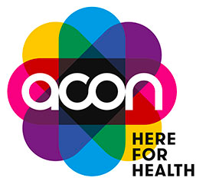
Randomized comparison of the preference and usability of two HIV self-testing kits among Australian gay and bisexual men
Jason J. Ong^{1,2}, Kirsty Smith³, Muhammad Jamil⁴, Dana Y.L. Lee², Ruthy McIver⁵, Rebecca Wigan⁶, Marti Kaiser⁶, Kate Maddaford⁶, Anna McNulty⁵, John Kaldor³, Christopher K. Fairley^{2,6}, Rebecca Guy³ on behalf of the PUSH study group*
¹ Department of Clinical Research and Development, London School of Hygiene and Tropical Medicine, London, UK; ² Central Clinical School, Monash University, Australia; ³ Kirby Institute, University of New South Wales, Sydney, Australia;
⁴ World Health Organization, Geneva, Switzerland; ⁵ Sydney Sexual Health Centre, Sydney, Australia; ⁶ Melbourne Sexual Health Centre, Melbourne, Australia
*PUSH study group also includes: Benjamin Bavinton, Marcus Chen, Eric Chow, Damian Conway, Andrew Grulich, Martin Holt, Adam Hynes, Karl Johnson, Garrett Prestage, Mark Stoove
BACKGROUND
HIV self-testing is acceptable and increases uptake of testing
In many high-income settings, only one test has received regulatory approval
To our best knowledge, there is no randomized real-world preference and usability study of HIVST among gay, bisexual and other men who have sex with men (GBM) living in a high-income country
RESULTS
Study population
Median age 34 years [IQR 29-43]
57% born outside Australia
77% completed tertiary education
9% had never tested or tested for HIV more than one year ago.
47% >6 sexual partners in the last six months
Future use
Overall preference
58% Oraquick (95% CI: 50-65)
41% AtomoRapid (95% CI: 33-49)
1% no preference (95% CI: 0-5)
Compared to Australian-born GBM, men born overseas had:
21.3% greater odds of using HIVST (95% CI: -2.0, 50.1)
29.3% greater odds to give HIVST kit to a regular partner (95% CI: 2.6, 63.0)
45.7% greater odds to give HIVST to a casual partner (95% CI: 13.5, 87.1)
METHODS
Who participated?
170 GBM, age >18 years and HIV-negative recruited from two sexual health clinics in Australia and Grindr
What did they do?
Participants used two self-test kits in random order (one oral, one finger-prick test)
Completed a questionnaire regarding their testing experience
A study nurse observed the participant during self-testing to note any deviations from kit instructions
Statistical analysis
Multivariable models were used to examine factors associated with future use of HIVST kits – adjusted for age, education and ethnicity.
To purchase the Atomo kit in Australia, buyers must watch an instructional video. In our study, we made this optional and only 5% watched the video.
CONCLUSIONS
1) HIVST kits were particularly appealing to GBM born outside of Australia (a group at higher risk for HIV compared to Australian-born)
2) Both oral and finger-prick HIVST kits should be made available to optimize uptake of HIVST.
3) Errors were relatively common in an educated group of men. Further refinements of the instructions and kit design might improve usability.
PRESENTED AT THE 23RD INTERNATIONAL AIDS CONFERENCE (AIDS 2020) | 6-10 JULY 2020
Contact: Jason.Ong@monash.edu @DrJasonJOng

